Slide 1
Smart Green Mind
Demo demonstration

Slide 2
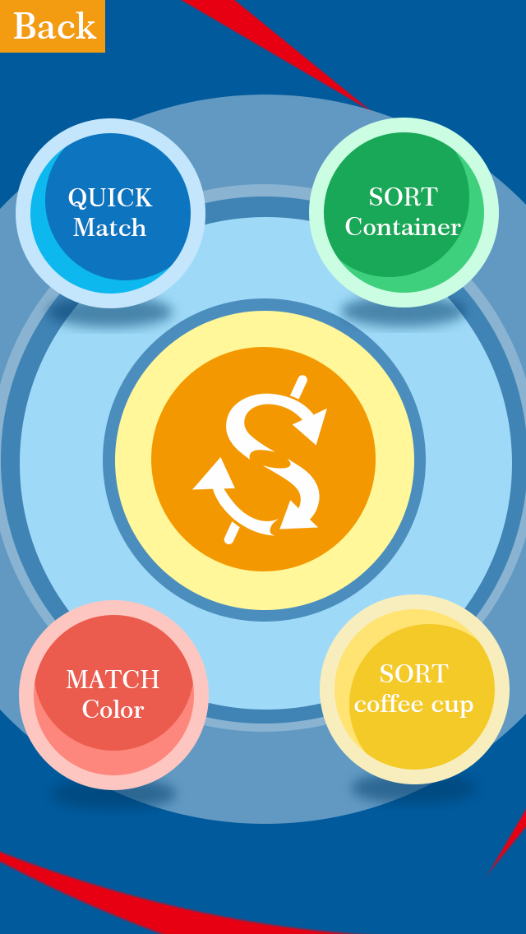
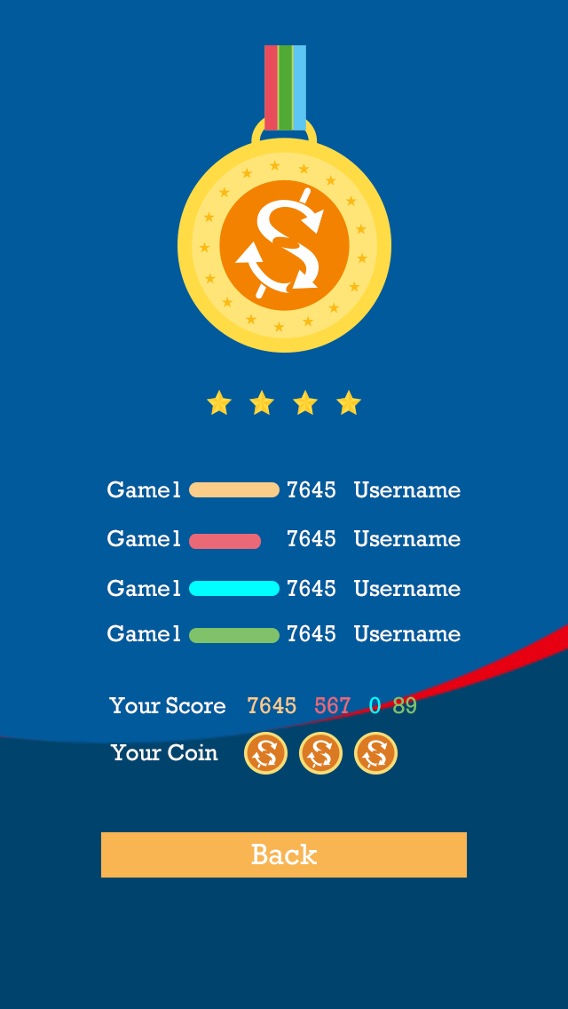
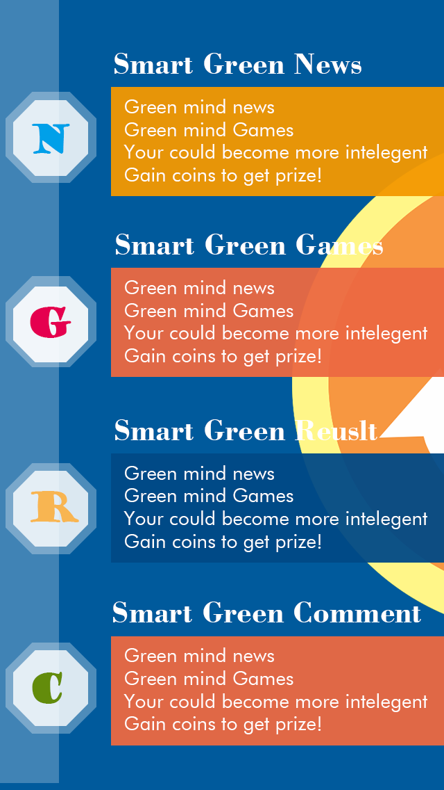
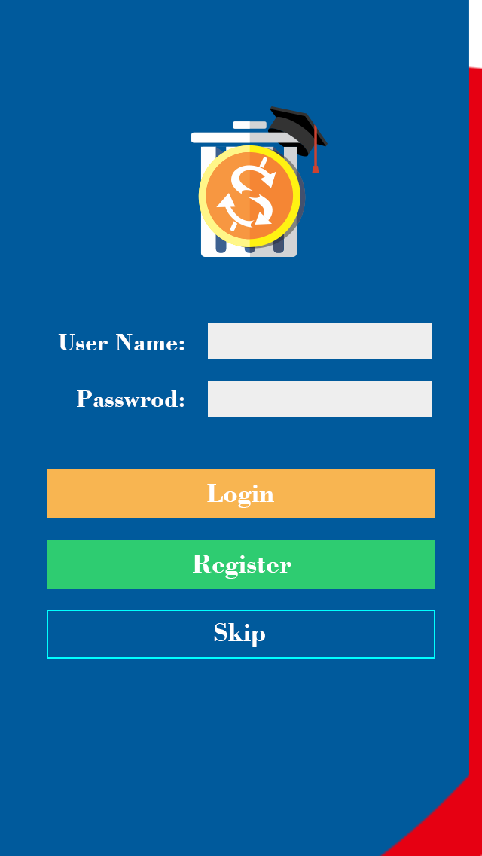

Game Menu Page
Result Page
Main Page
Login Page
Loading Page

Slide 3
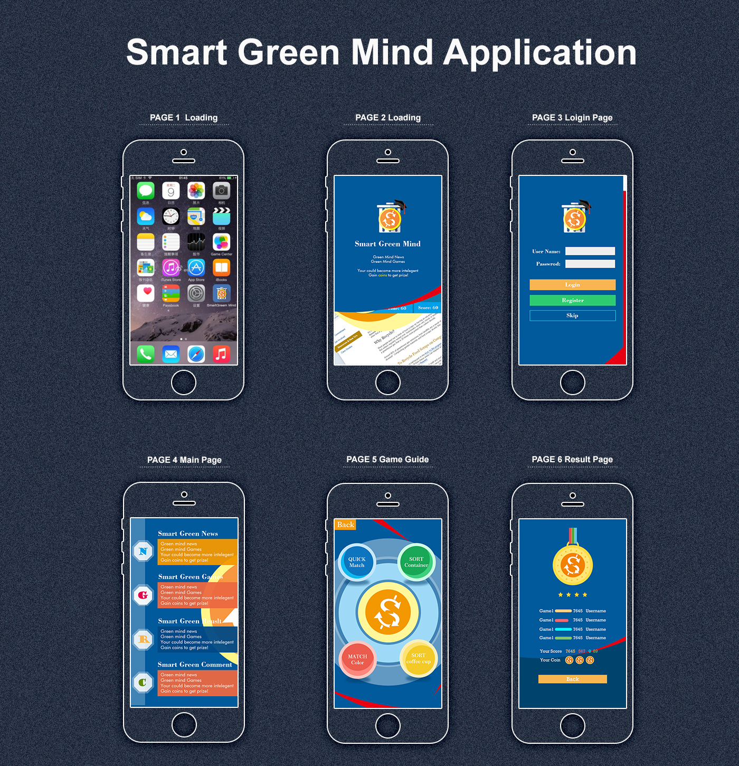
Visual Screen

Slide 4
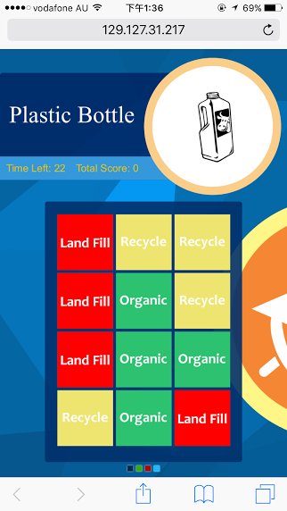
Game1 Match colour According to the waste given by game, player need to choose all correct colours Game2 Quick Sort Sort waste correctly Game3 Sort coffee cup Sort coffee cup Game4 container sort Sort containers

Slide 5

Game1 Match colour According to the waste given by game, player need to choose all correct colours Game2 Quick Sort Sort waste correctly Game3 Sort coffee cup Sort coffee cup Game4 container sort Sort containers

Slide 6
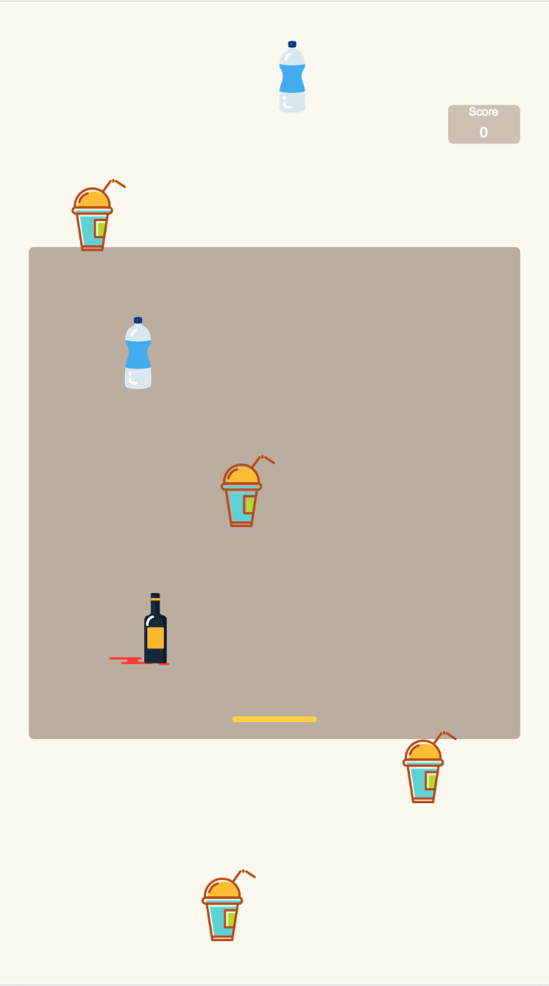
Game1 Match colour According to the waste given by game, player need to choose all correct colours Game2 Quick Sort Sort waste correctly Game3 Sort coffee cup Sort coffee cup Game4 container sort Sort containers

Slide 7
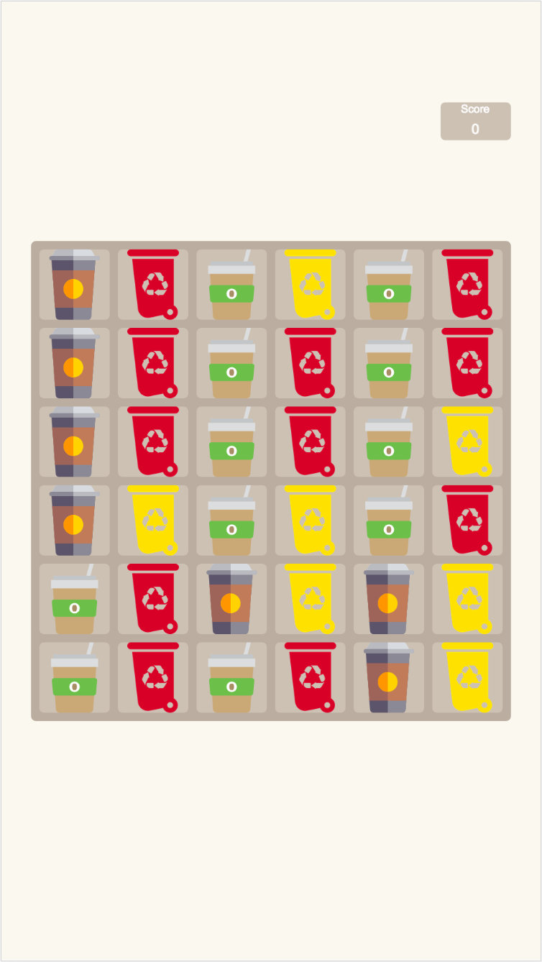
Game1 Match colour According to the waste given by game, player need to choose all correct colours Game2 Quick Sort Sort waste correctly Game3 Sort coffee cup Sort coffee cup Game4 container sort Sort containers

